Slide 1
LOAN APPLICATION DATASET
KEERTHANA.D - JUNE BATCH
18.08.2025

Slide 2
INTRODUCTION
The loan dataset contains information about applicants who have applied for loans, including their personal, financial, and employment details.
Typical features include applicant income, co-applicant income, loan amount, loan term, credit history, education, marital status, and employment details.
The dataset is commonly used to analyze factors that influence loan approval, detect patterns in borrower behavior, and build predictive models to support financial decision-making.
Exploratory Data Analysis (EDA) on this dataset helps in understanding data distribution, relationships between variables, and identifying missing values before modeling.

Slide 3
PROBLEM STATEMENT
Deciding whether to approve a loan is challenging for banks and financial institutions.
Without proper analysis, there is a risk of giving loans to applicants who may not be able to repay, or rejecting those who are capable.
This project aims to analyse loan applicant data to find important factors that can help in making better and more accurate loan approval decisions.

Slide 4
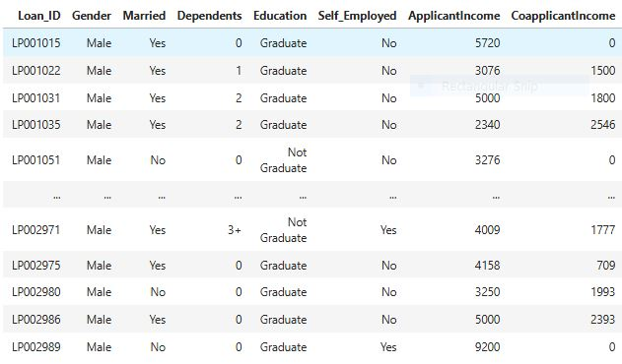
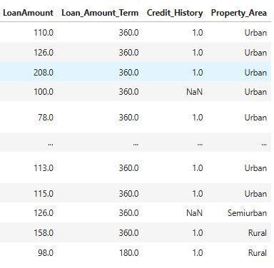
DATASET OVERVIEW
Rows: 367 records
Columns: 12 features

Slide 5

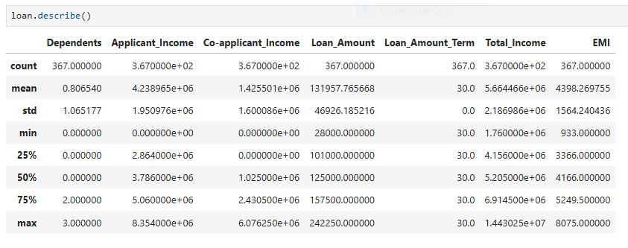
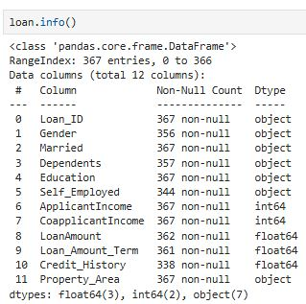
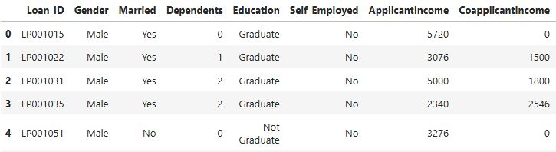
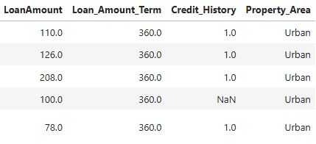
DATA UNDERSTANDING

Slide 6
DATA CLEANING
What ?
Data cleaning is the process of identifying and correcting errors or missing values in a dataset to ensure it is accurate and ready for analysis.
Why ?
Data cleaning is essential because raw data often contains missing values, errors, duplicates, or inconsistencies.
Cleaning ensures that the dataset is accurate, consistent, and reliable, which is crucial for meaningful analysis, correct insights, and building effective predictive models.
High-Level Steps:
Handling missing values
Correcting inconsistent data
Removing duplicates
Outlier detection and treatment
Correcting data types
Final validation

Slide 7
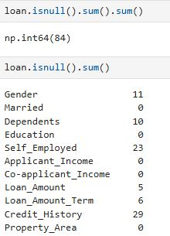
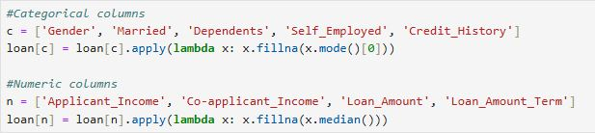
HANDLING MISSING VALUES
Approach:
Identify missing values in Gender, Dependents, Loan_Amount, Credit_History.
Impute numerical variables with mean/median.
Impute categorical variables with mode.

Slide 8
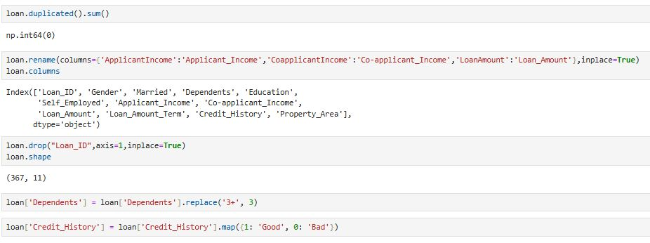
correcting inconsistent data
Invalid values are entries in the dataset that are incorrect, inconsistent or do not conform to the expected range.
These can affect the accuracy of analysis and predictions.

Slide 9
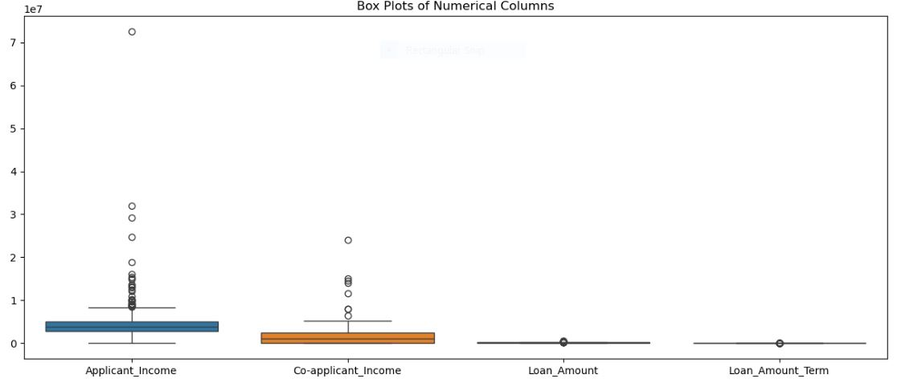
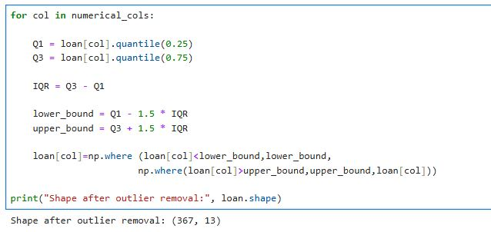
Outlier HANDLING
Identification:
Boxplots for numerical variables like Applicant_Income, Co-applicant_Income, Loan_Amount
Z-score or IQR method to detect extreme values

Slide 10
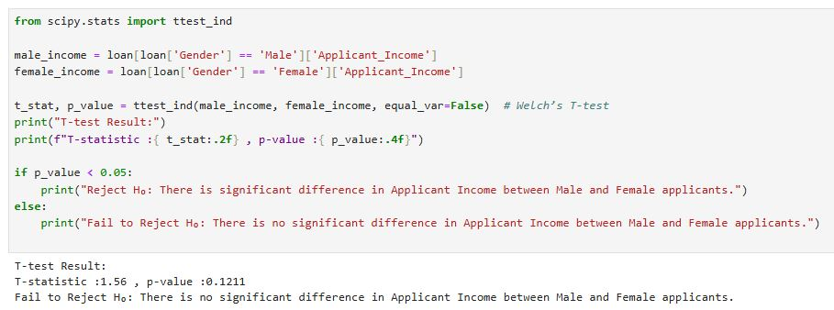
STATISTICAL ANALYSIS
Hypothesis 1: Independent two-sample t-test
H₀ (Null Hypothesis): Male and Female applicants have the same average income.
H₁ (Alternate Hypothesis): Male and Female applicants have different average incomes

Slide 11
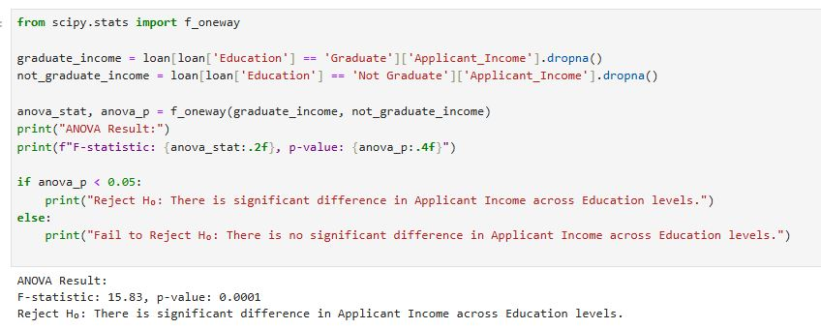
Hypothesis 2: One-way ANOVA test
H₀ (Null Hypothesis): Mean Applicant Income is the same for Graduates and Non-Graduates
H₁ (Alternate Hypothesis): Mean Applicant Income is not same for Graduates and Non-Graduates

Slide 12
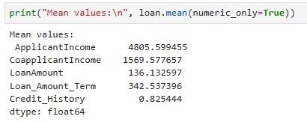
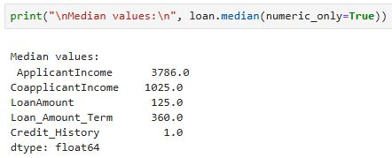
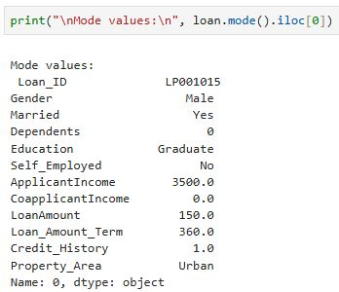
DESCRIPTIVE ANALYSIS

Slide 13
Data visualization
Data visualization is the process of representing data in the form of graphs, charts, and plots to make patterns, trends, and relationships easier to understand.
Instead of looking at raw numbers, visualizations allow us to quickly interpret insights.
Types of visualizations used:
Histogram
Bar Chart
Boxplot
Scatter Plot
Violin Plot
Heatmap / Correlation Matrix

Slide 14
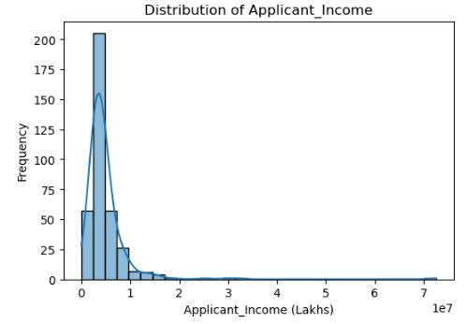
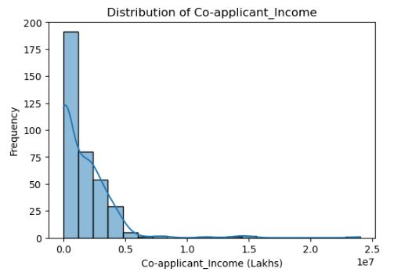
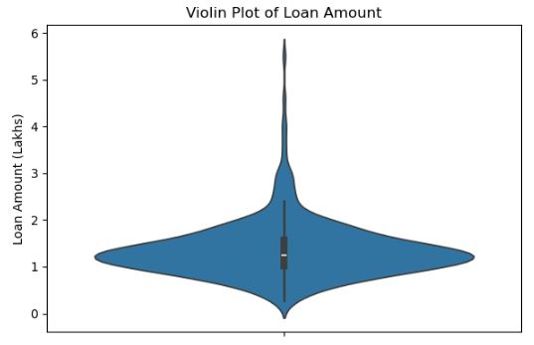
Univariate analysis
Visualizations:
Histogram for Applicant_Income
Histogram for Co-applicant_Income
Violin plot for Loan_Amount

Slide 15
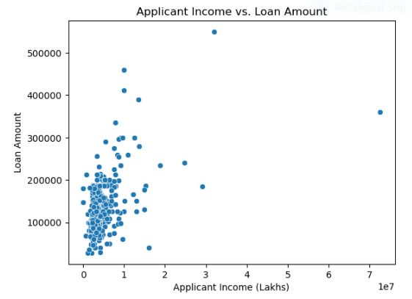
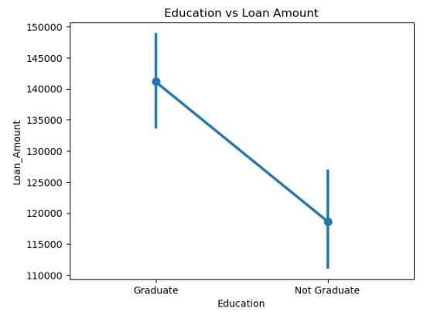
BIVARIATE ANALYSIS
Visualizations:
Scatter plot of Applicant_Income vs Loan_Amount .
Point plot of Education vs Loan_Amount .

Slide 16
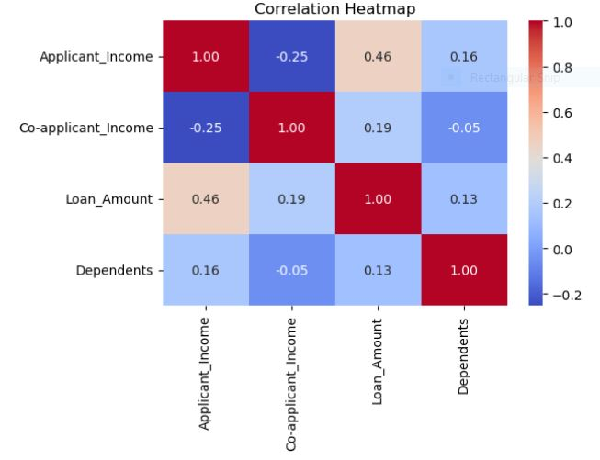
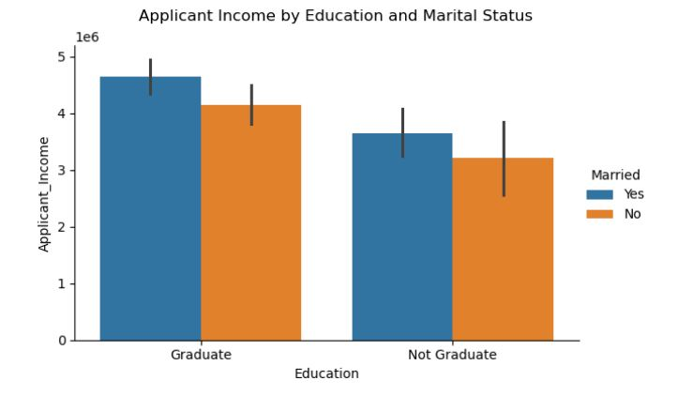
MULTIVARIATE ANALYSIS
Visualizations & Techniques:
Heatmap of correlations among numerical variables
Bar chart to observe interactions among Applicant_Income, Education and Marital_Status

Slide 17
CONCLUSION AND RECOMMENDATIONS
Key Findings:
Credit history is the strongest factor for loan approval .
Education and income influence approvals, but less than credit history .
Missing data and outliers needed careful handling for accurate analysis .
Recommendations:
Banks should focus on applicant’s credit history along with income and education .
Future analysis could include additional variables like employment duration or property details .
Future Work:
Build predictive models (logistic regression, decision trees) for loan approval .
Incorporate more financial factors for better prediction accuracy .

Slide 18


